Slide 1
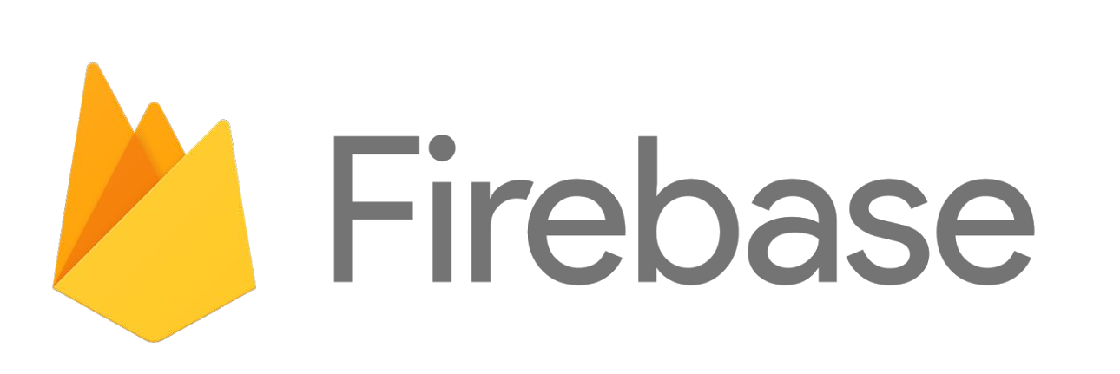

Slide 2
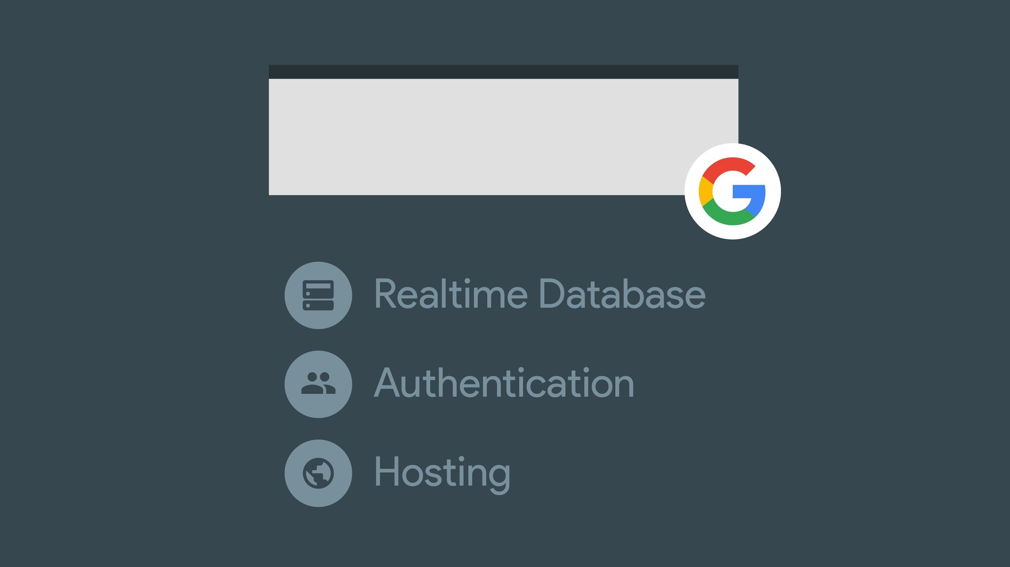


Slide 3
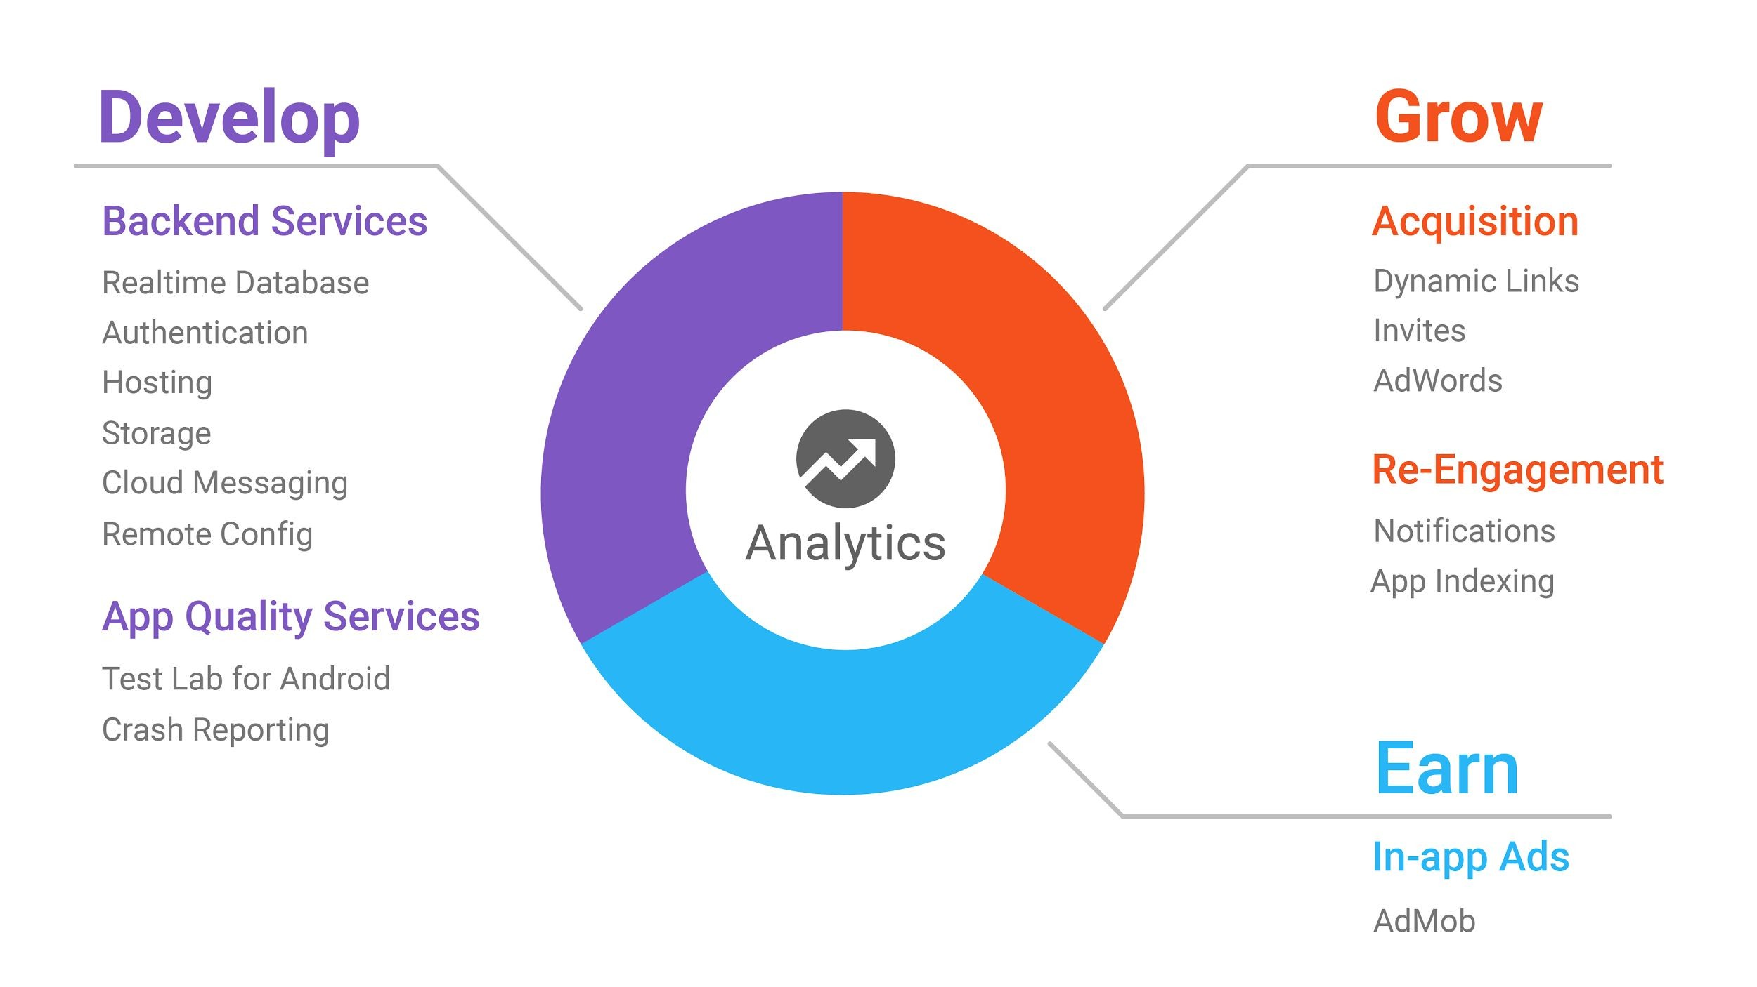
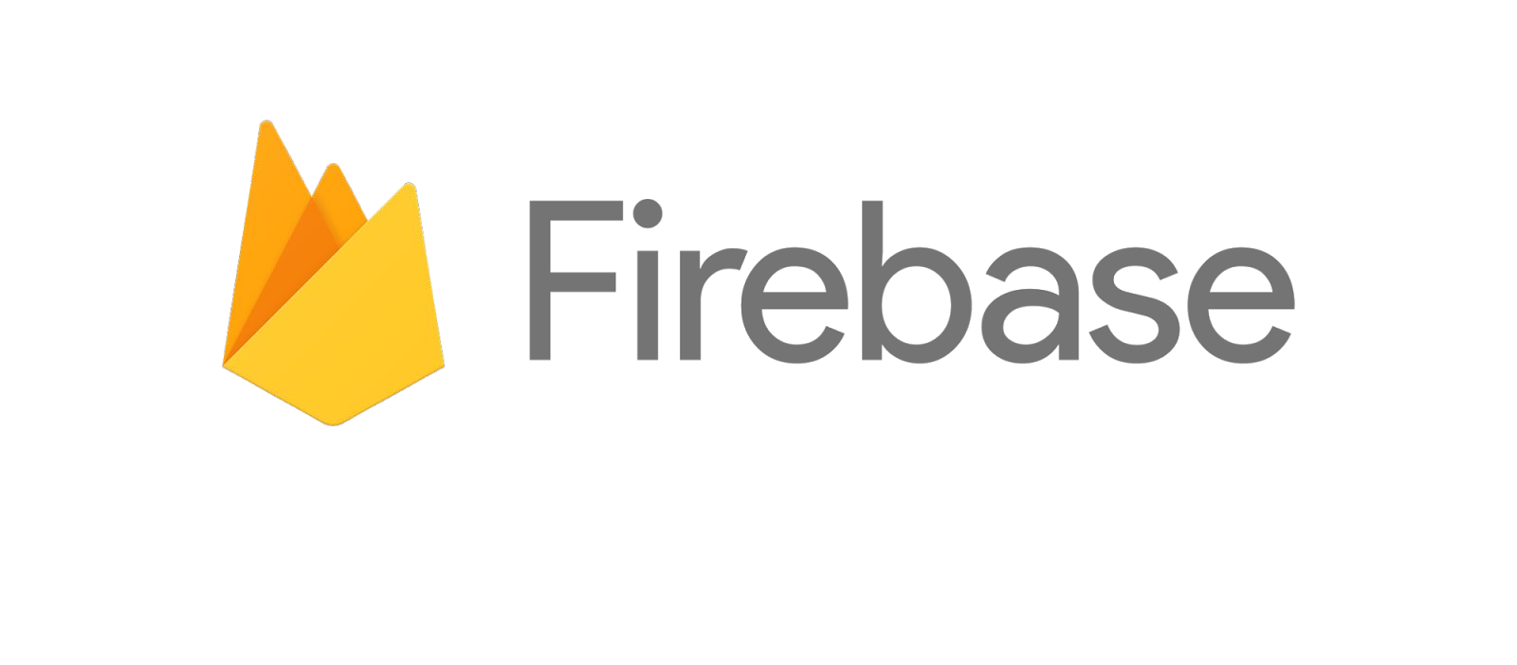

Slide 4
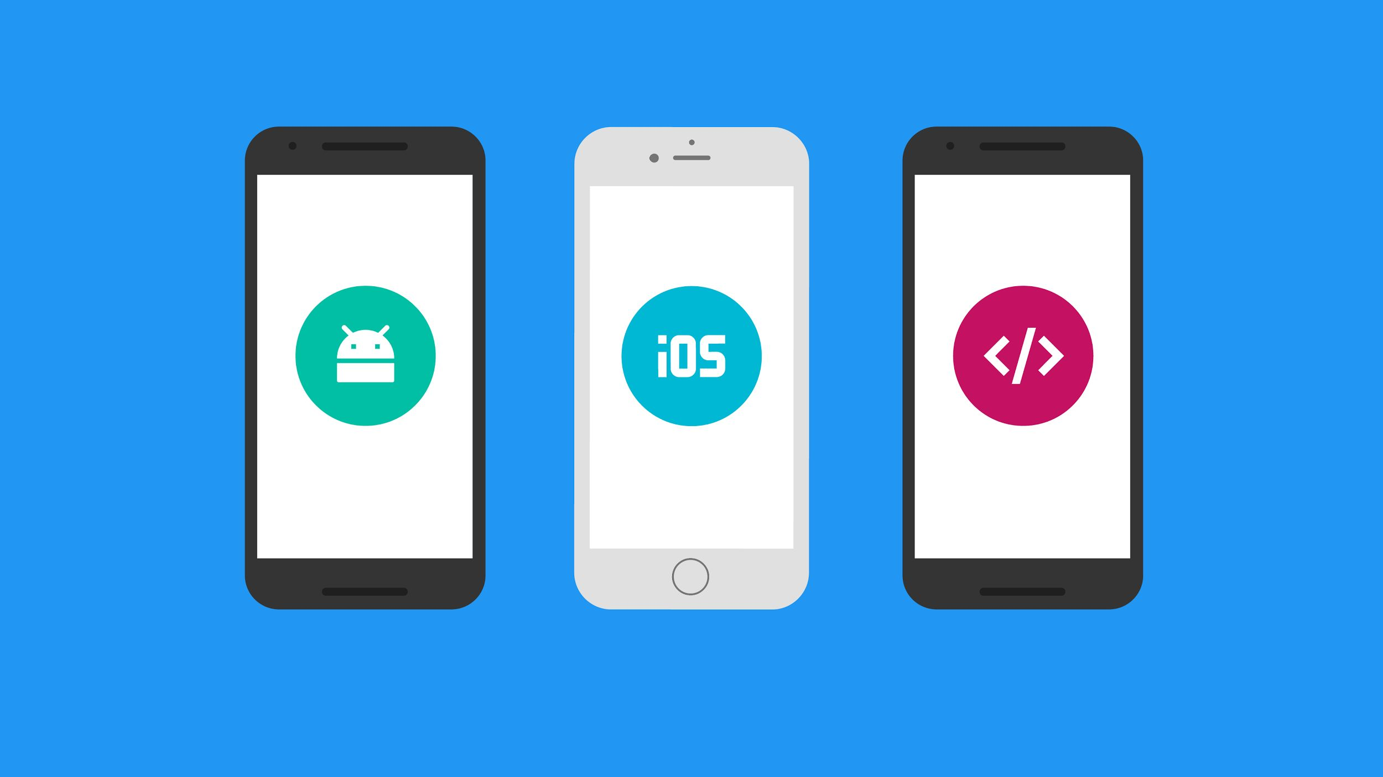

Cross-platform

Slide 5

Integrated

Slide 6
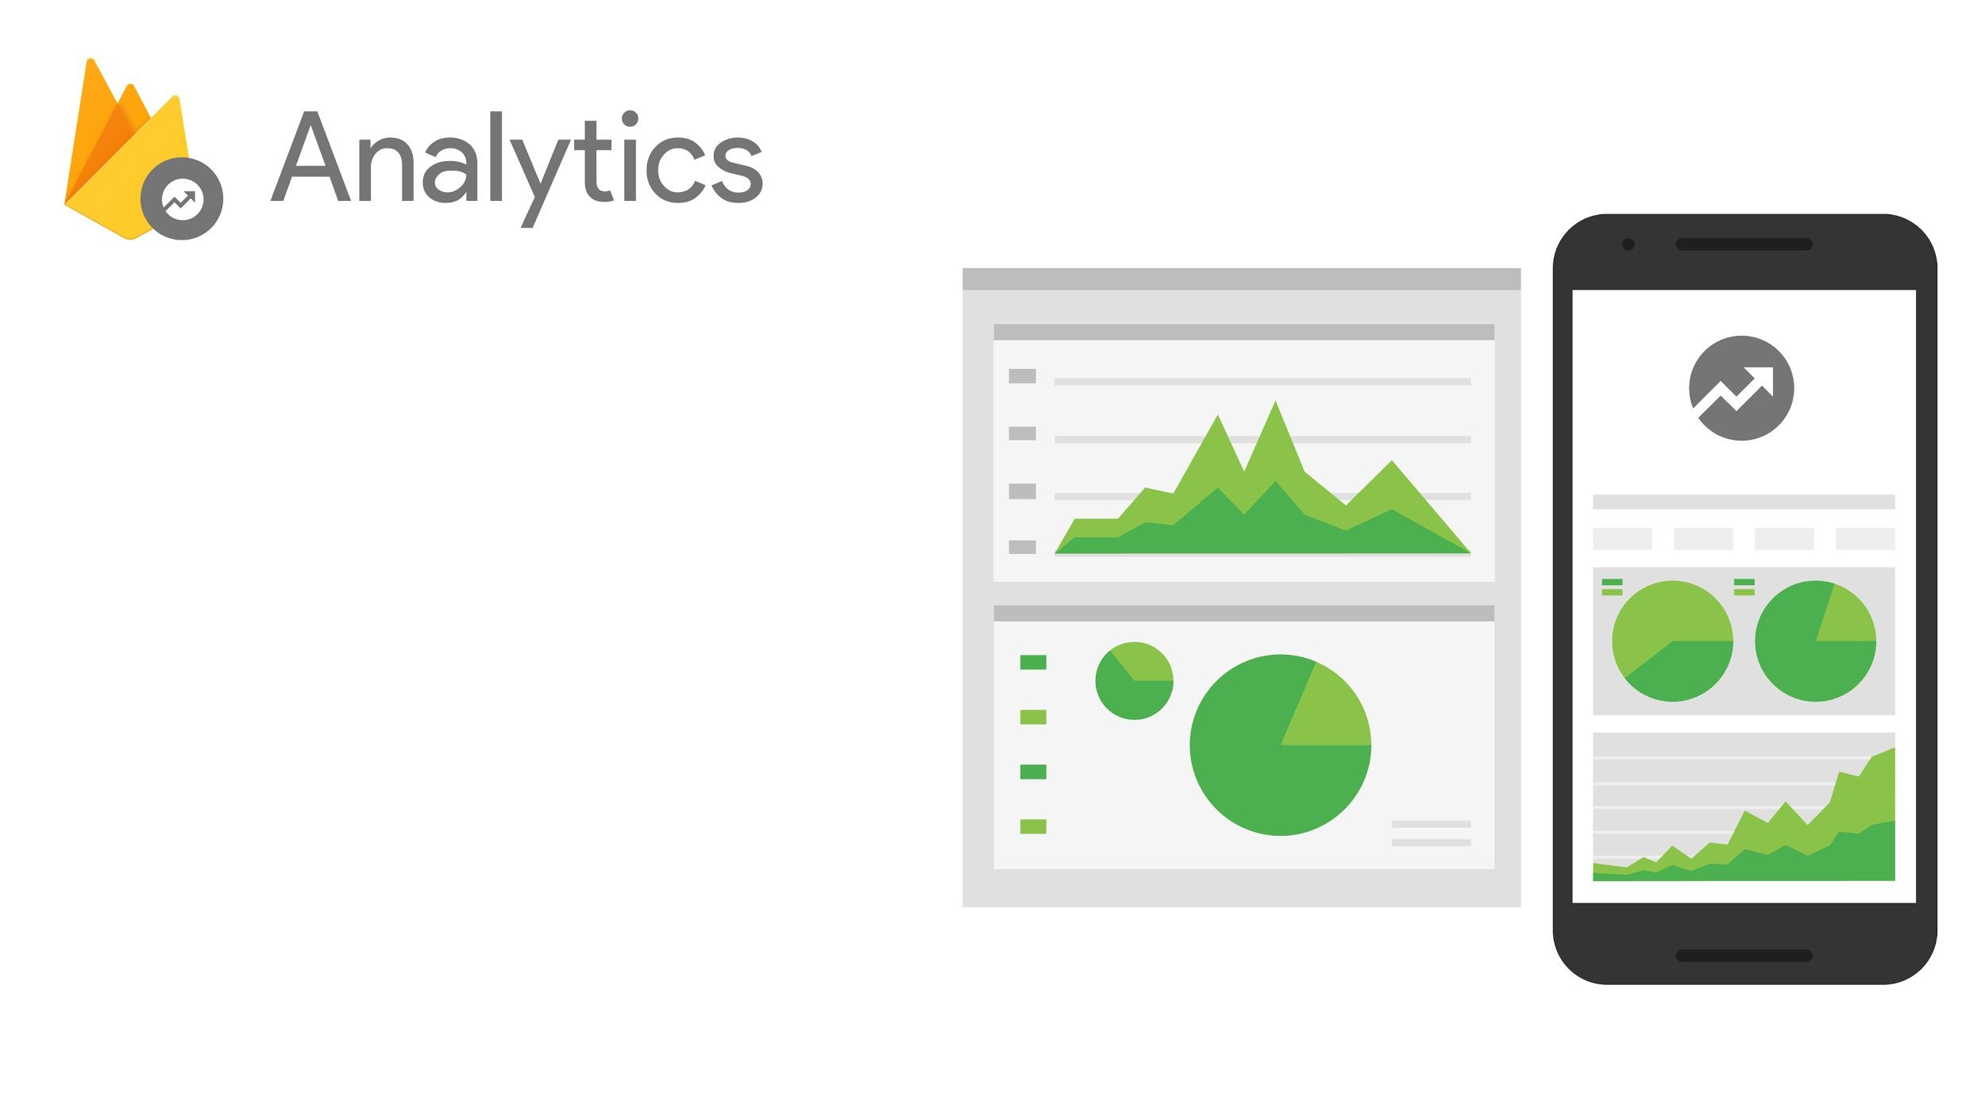
Designed for apps
Event and user centric
Connects across Firebase
Free & unlimited

Slide 7
Determine the effectiveness of notifications and update your re-engagement strategy.
Discover what in-app activities trigger in-app purchases and surface these appropriately; improve your user's experience to increase engagement and monetization.
Remote Config can target custom app experiences at members of different Analytics audiences and measure the impact of their experiments using Analytics reports.
Analytics will provide campaign attribution reporting for AdWords, App Indexing, App Invites, Dynamic Links, and Notifications.

Slide 8
Developing your app

Slide 9
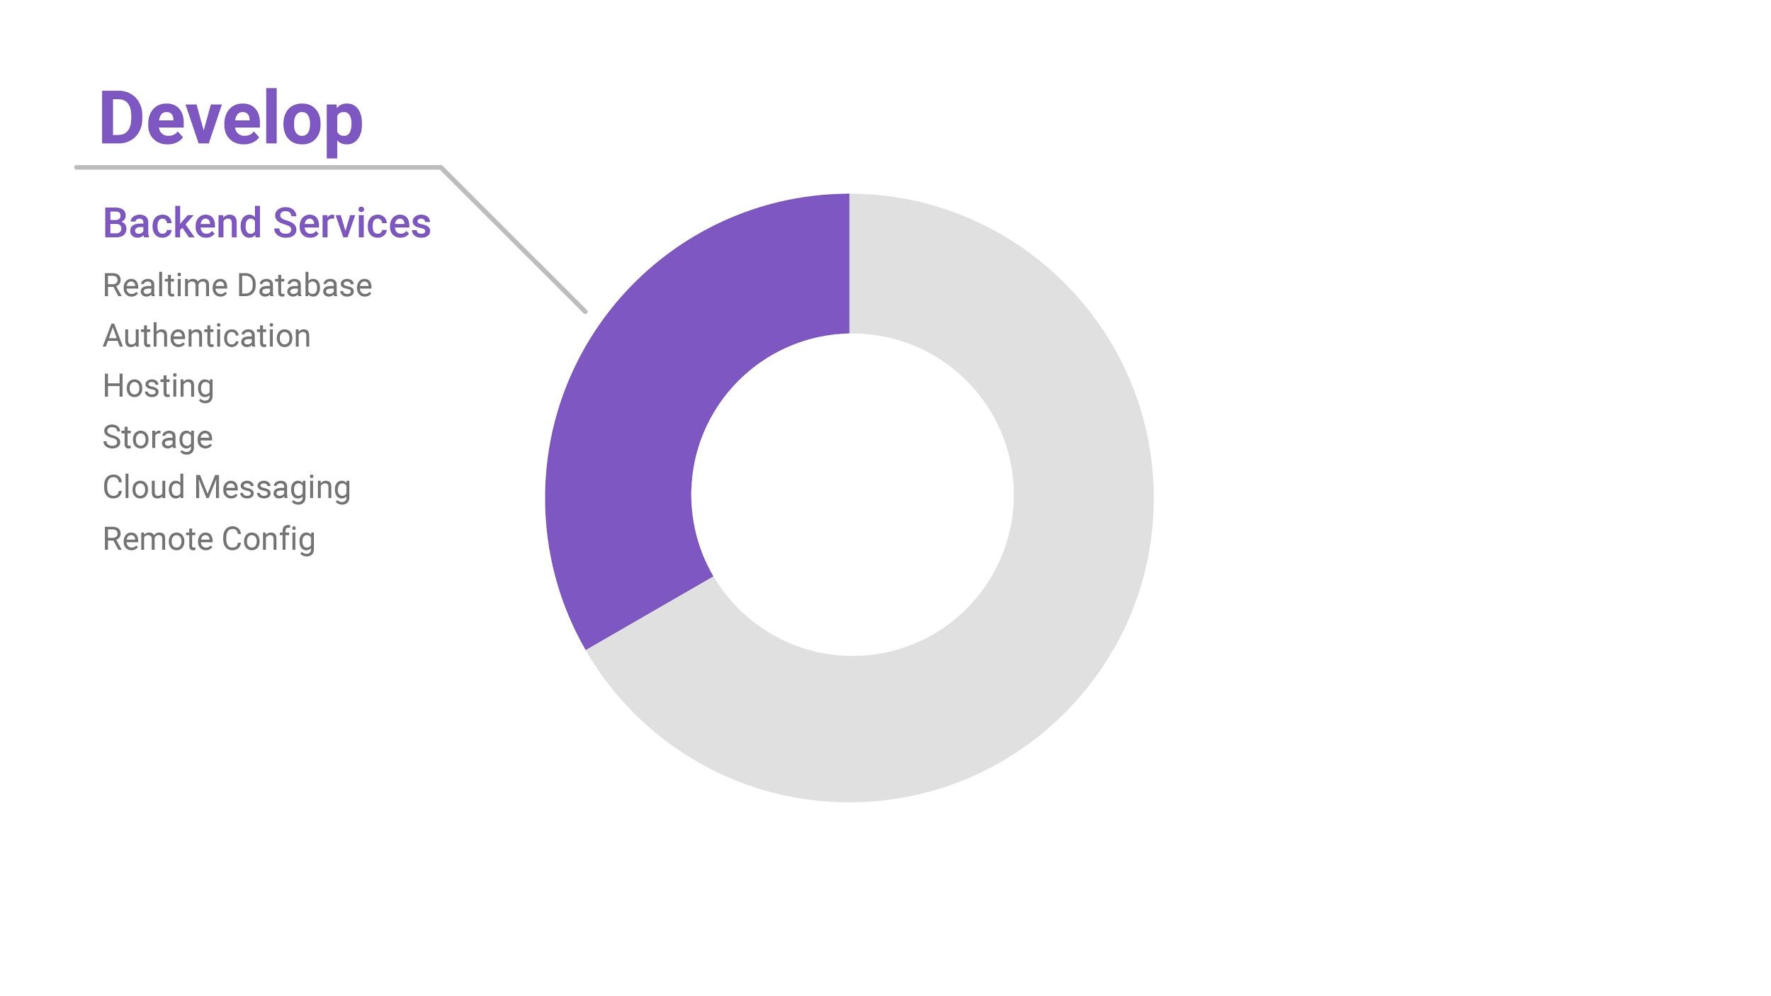
Backend Services

Slide 10
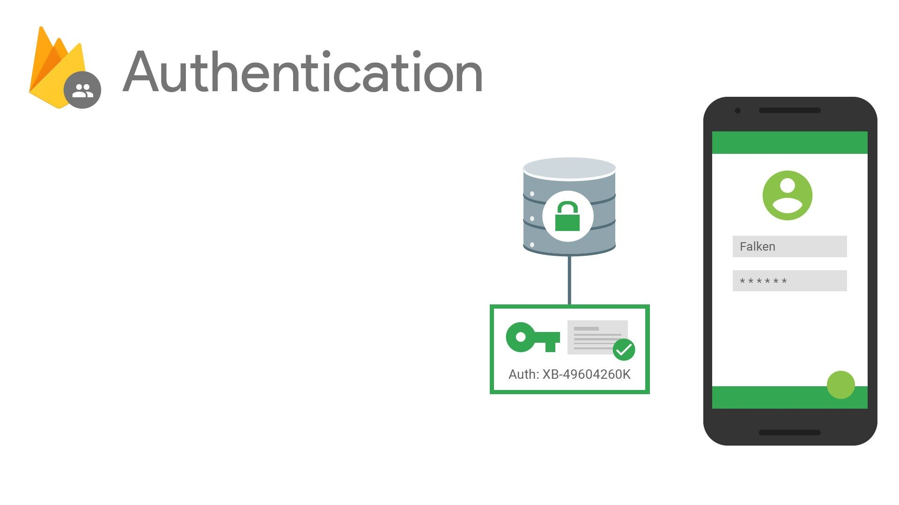
Authentication & account management
Supports:
Email & password
Social providers
Existing auth systems
[New!] Out-of-the box UI

Slide 11
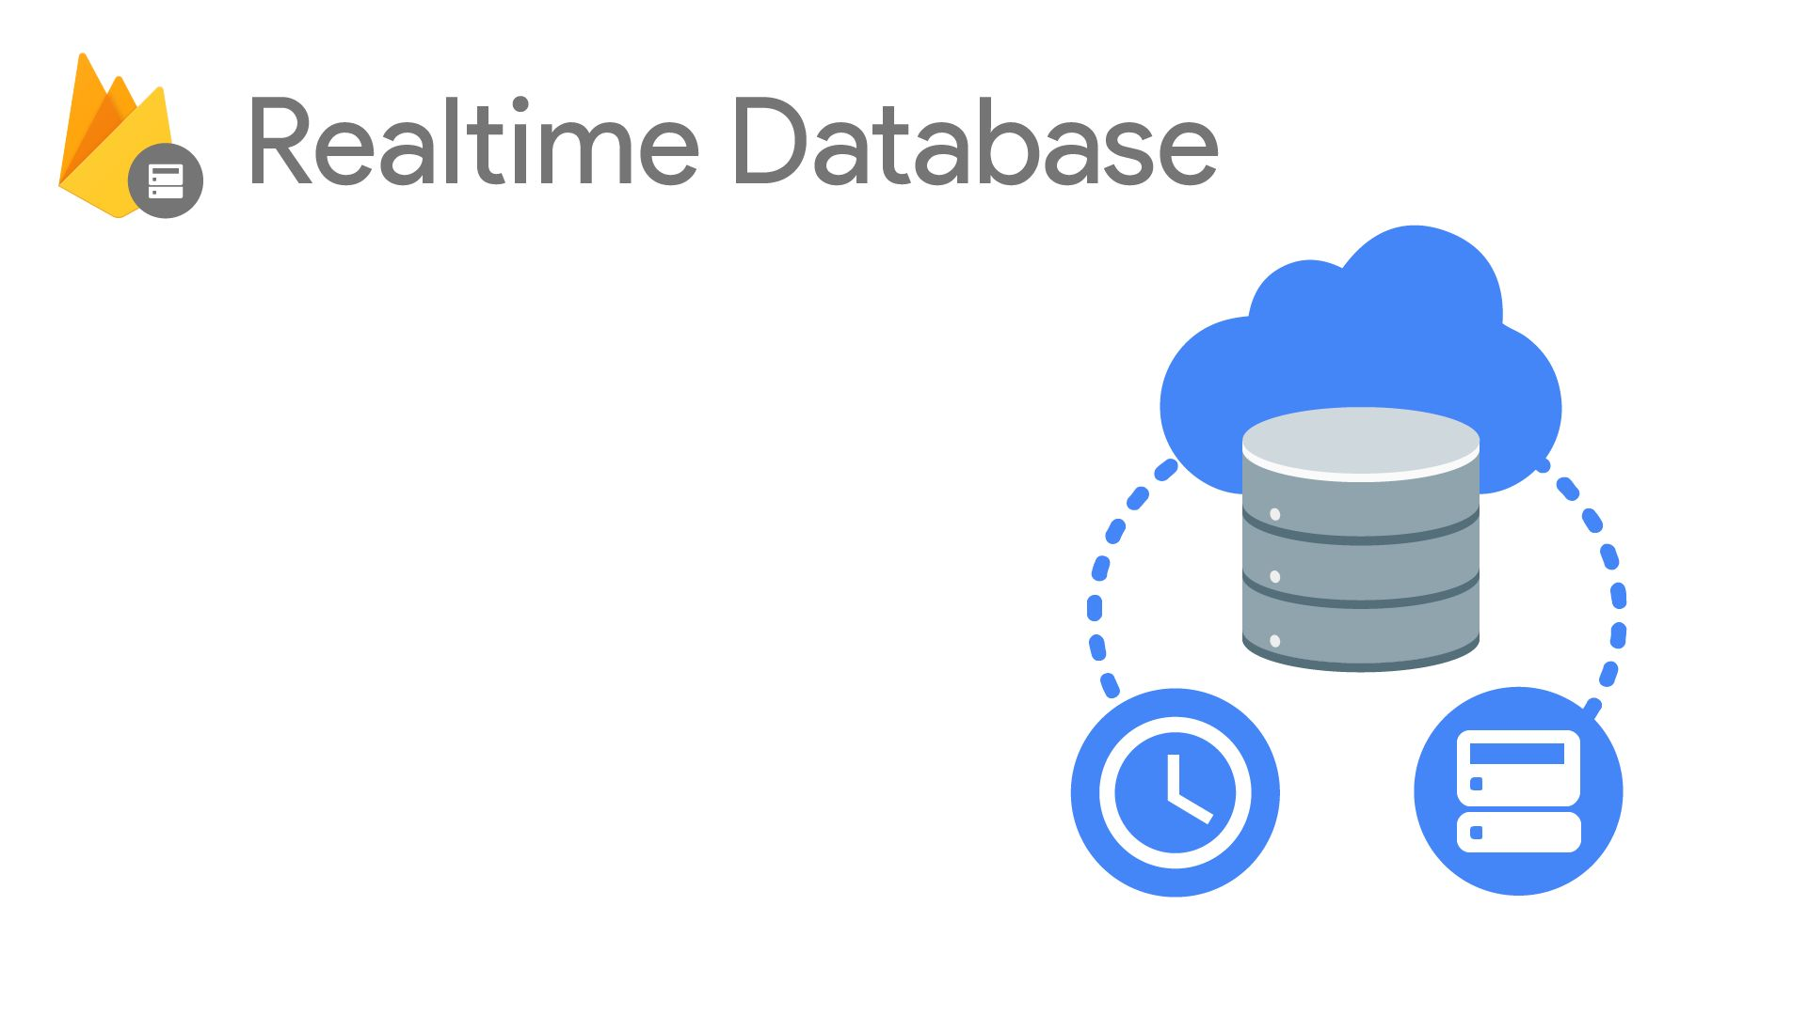
Cloud-hosted NoSQL database
Synchronization & conflict resolution
Access directly from your app

Slide 12
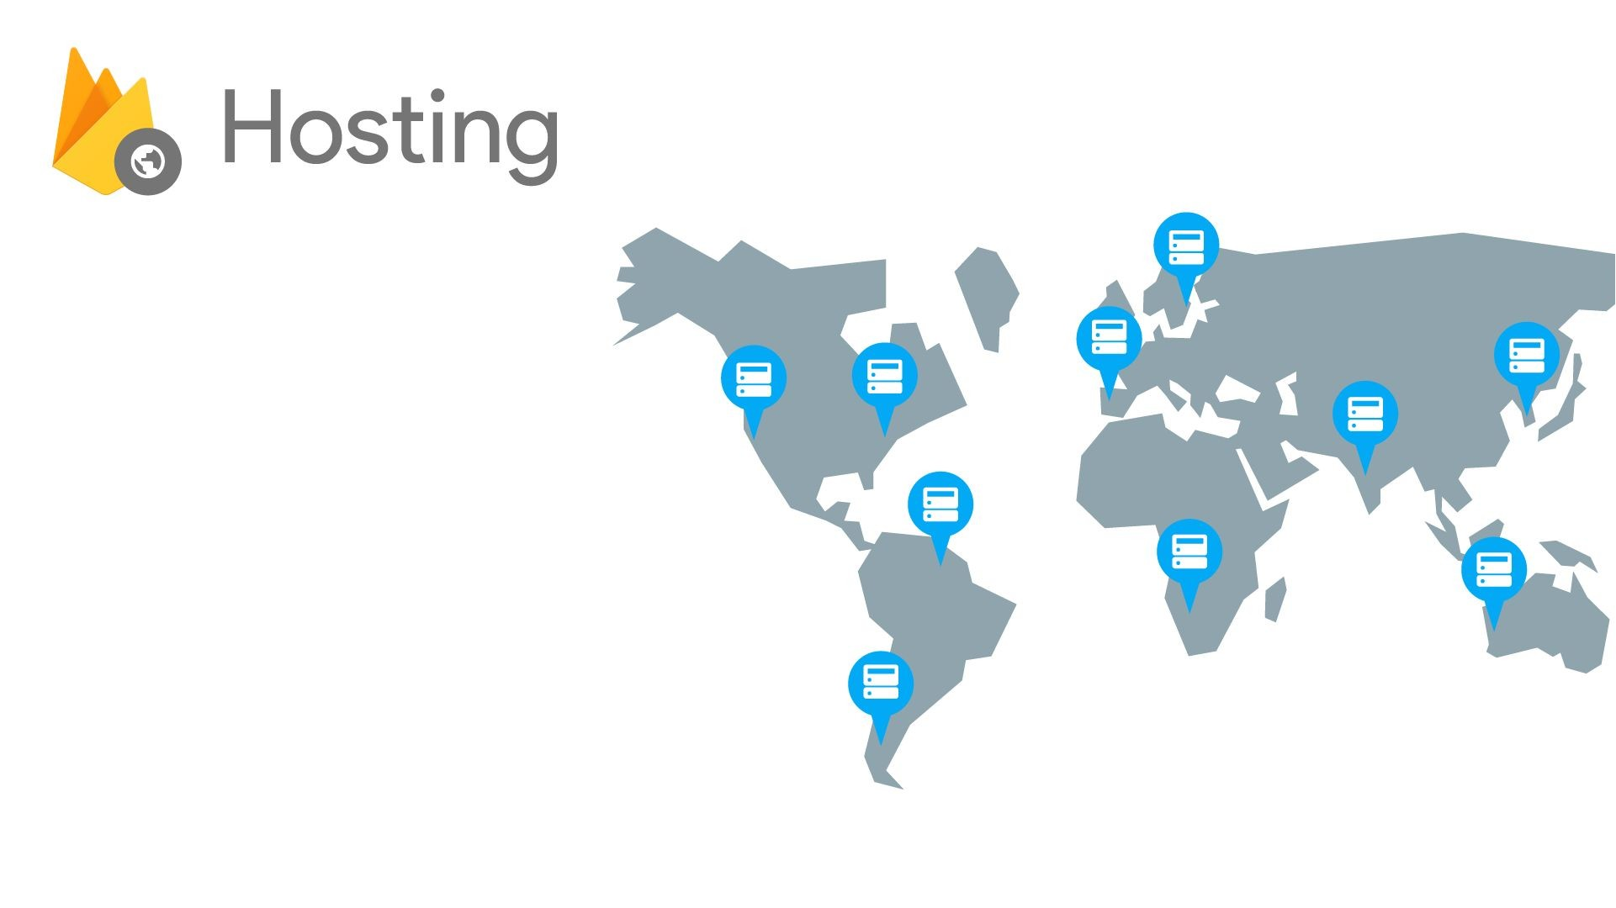
SectionX SectionY SectionZ
Serve static assets (images too)
SSL by default
New: free custom domains

Slide 13
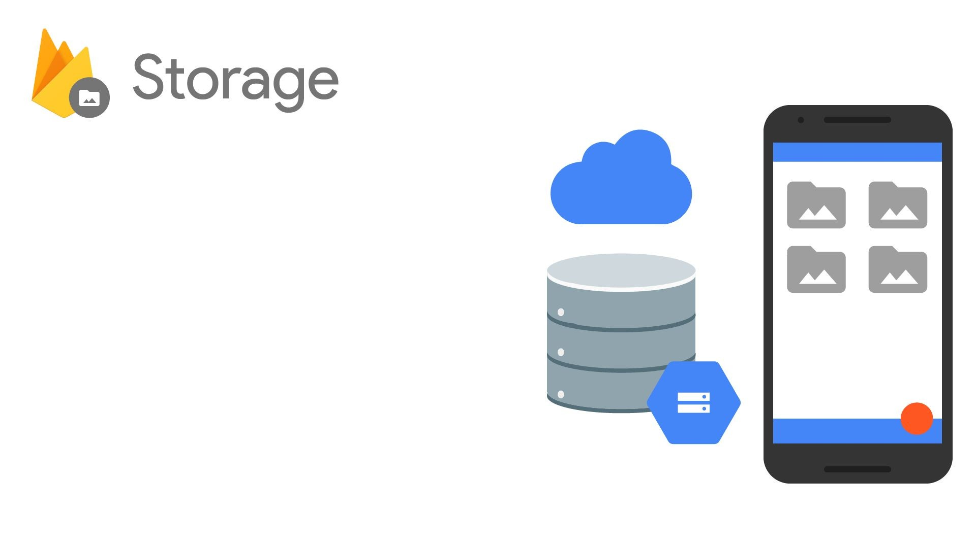
Easy file storage
Handles poor connectivity
Backed by & accessible from Google Cloud Storage

Slide 14
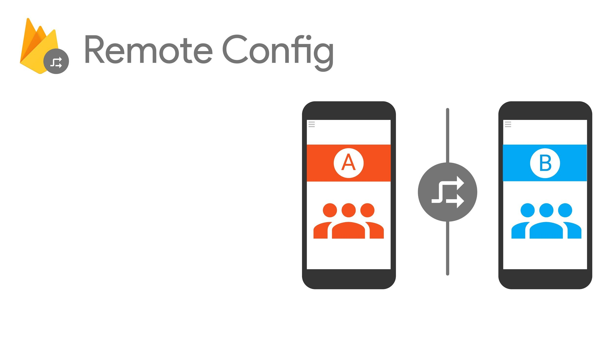
Run A/B experiments or change app behavior
Control custom key-value pairs from the Console
Changes propagate instantly

Slide 15
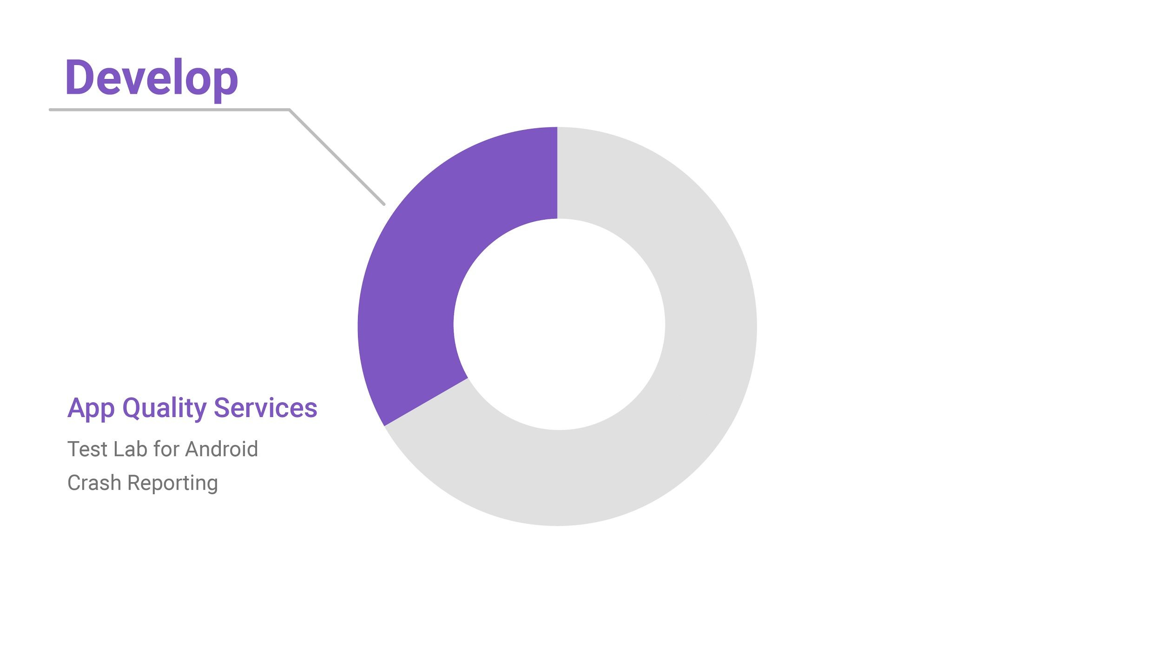
App Quality Services

Slide 16
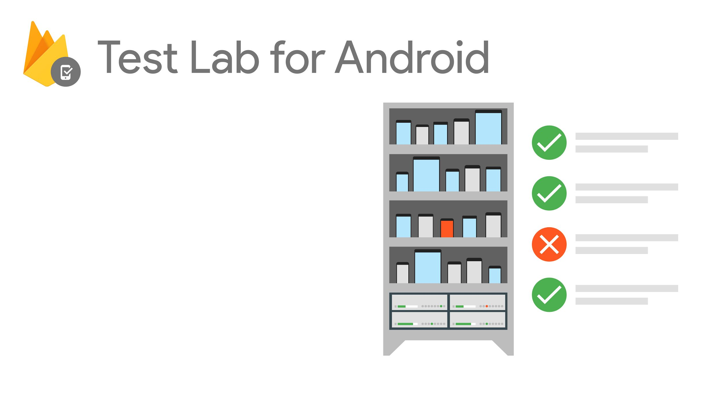
Test on the most popular devices before you ship
Reports & screenshots
Robo & custom tests

Slide 17
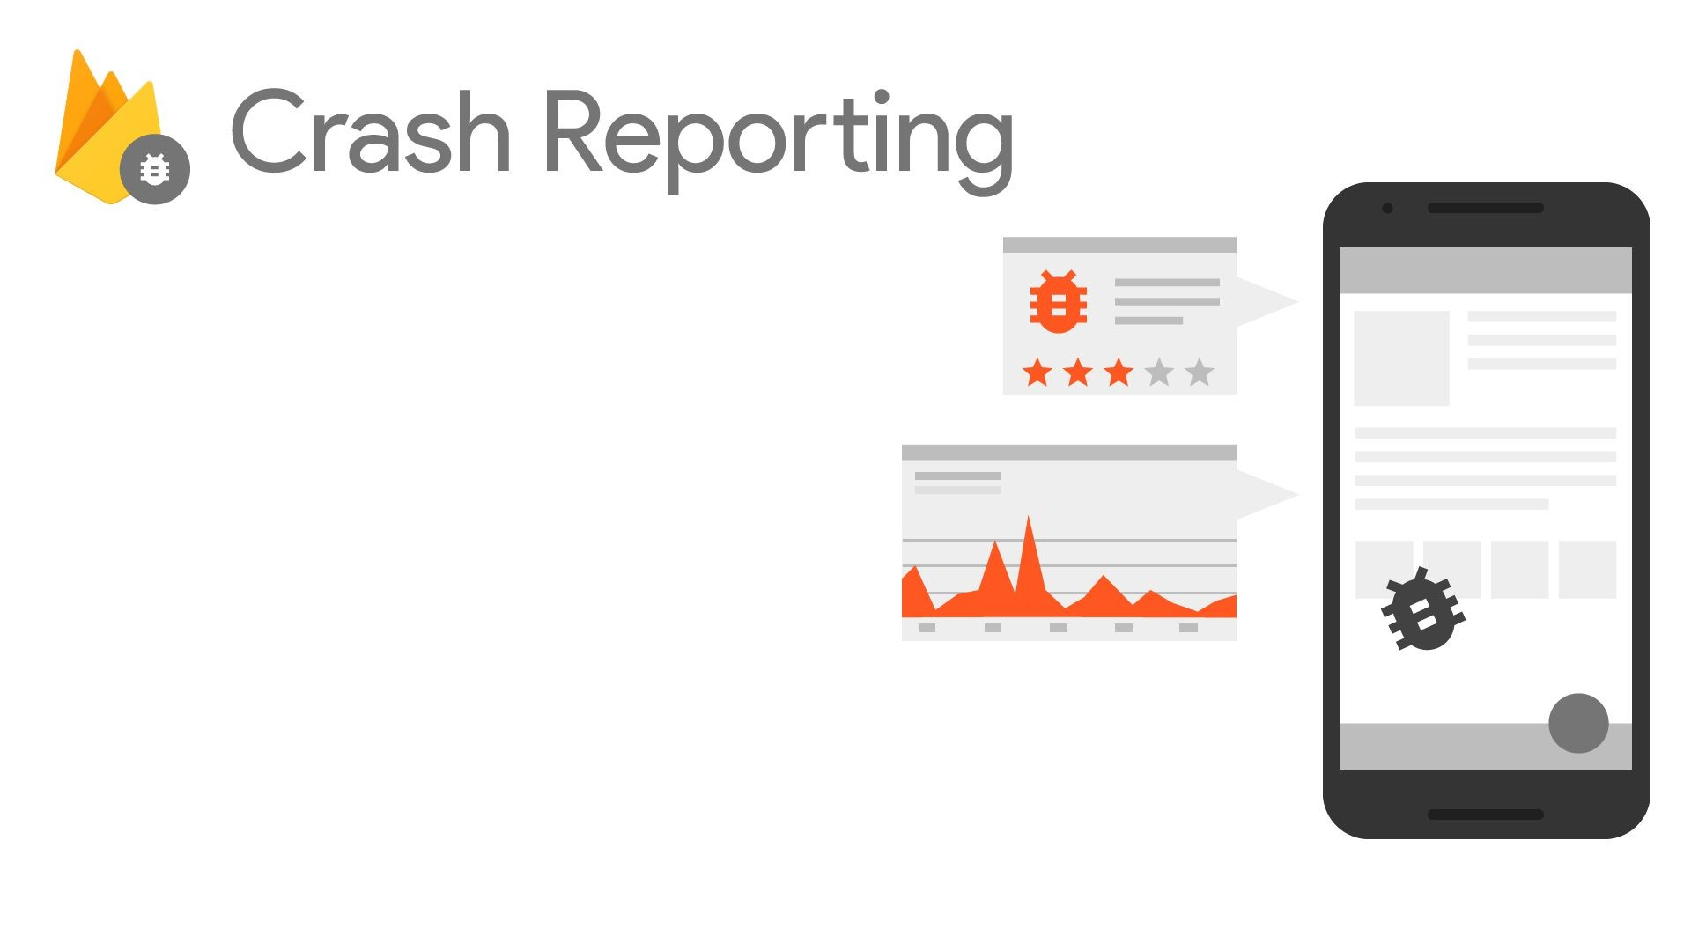
See crashes & impact
Version & OS drill-down
Integrated with Analytics

Slide 18
Grow your app

Slide 19
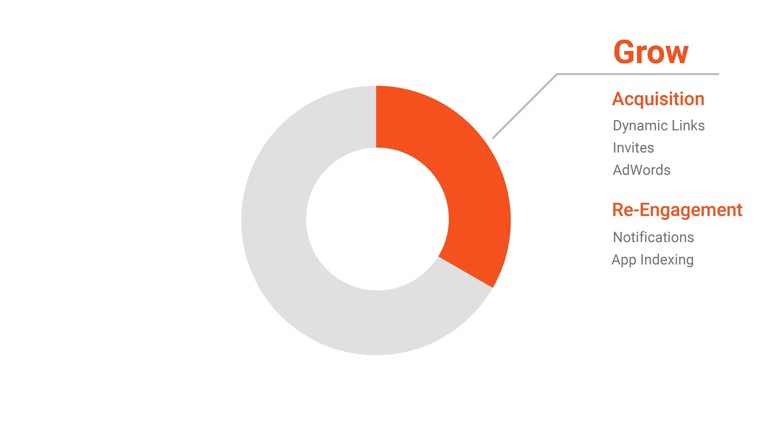

Slide 20
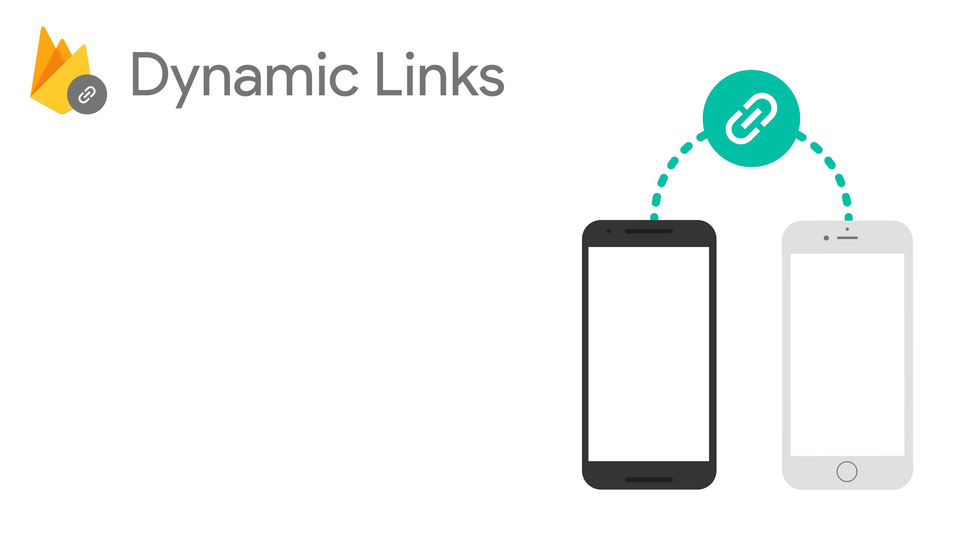


Customize different user experiences via a single URL
Works across platforms
Preserves URL state, even through app install flow
Analytics insights

Slide 21
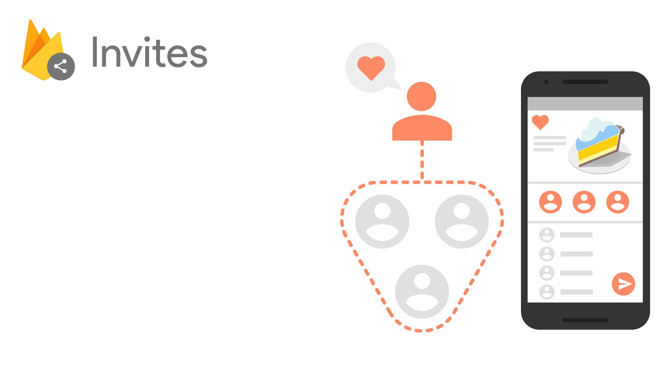
Drop-in widget for app sharing
Supports SMS and Email
Recipient suggestions from Google
Built on Dynamic Links

Slide 22
in action
Share 15% off, for you and friends!
SEND
Get 15% off y our first
o rder

Slide 23
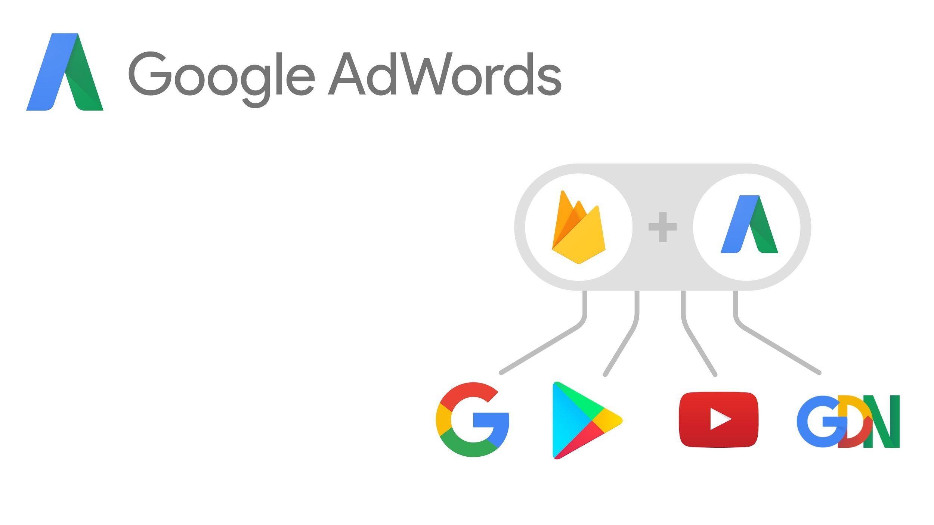
Universal App Campaigns
2B downloads to date
Android & iOS
Audience re-targeting
Conversion tracking and optimization

Slide 25
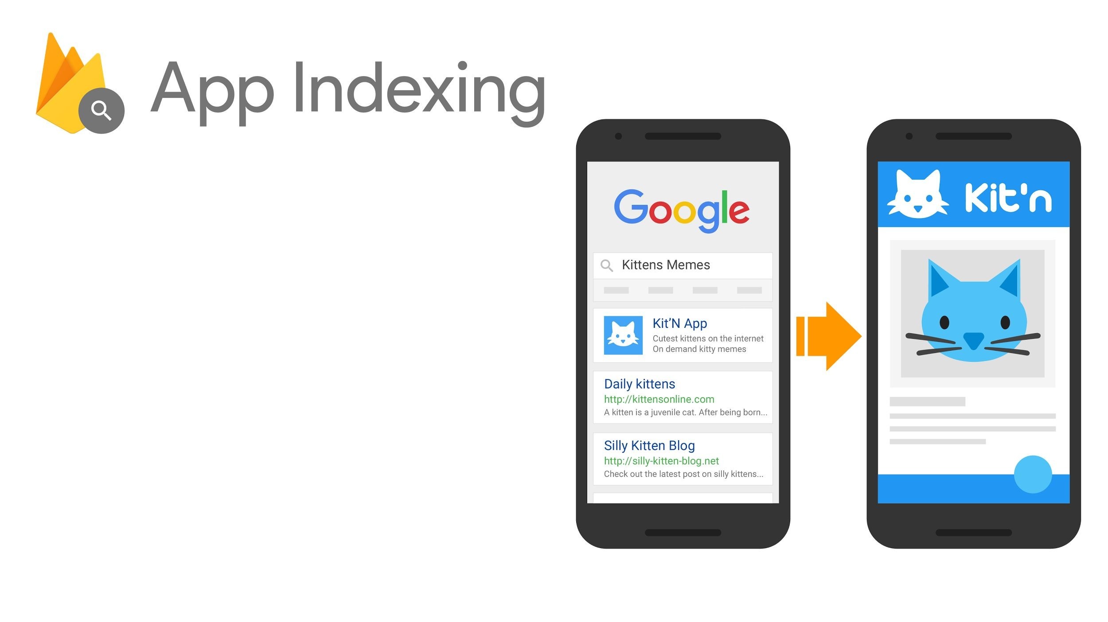
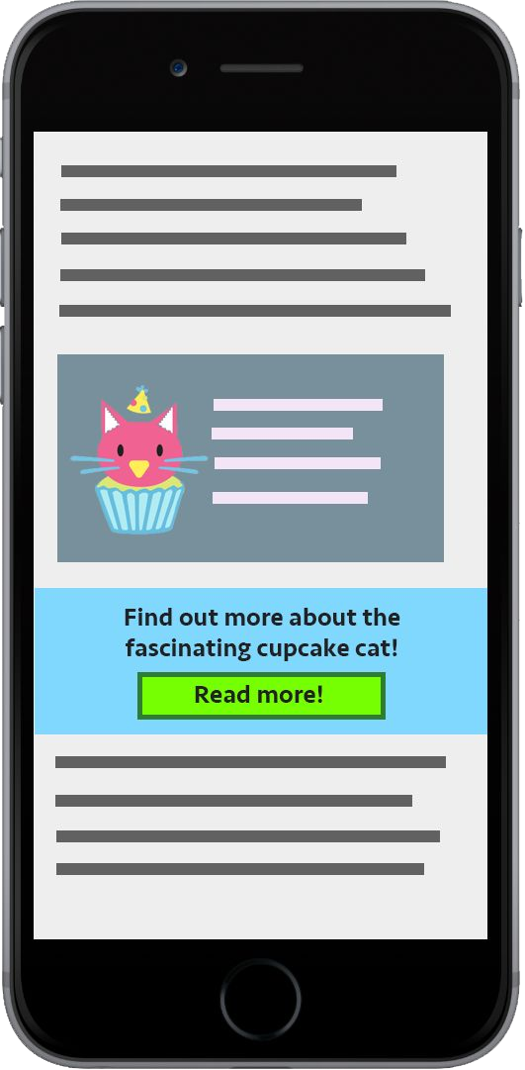

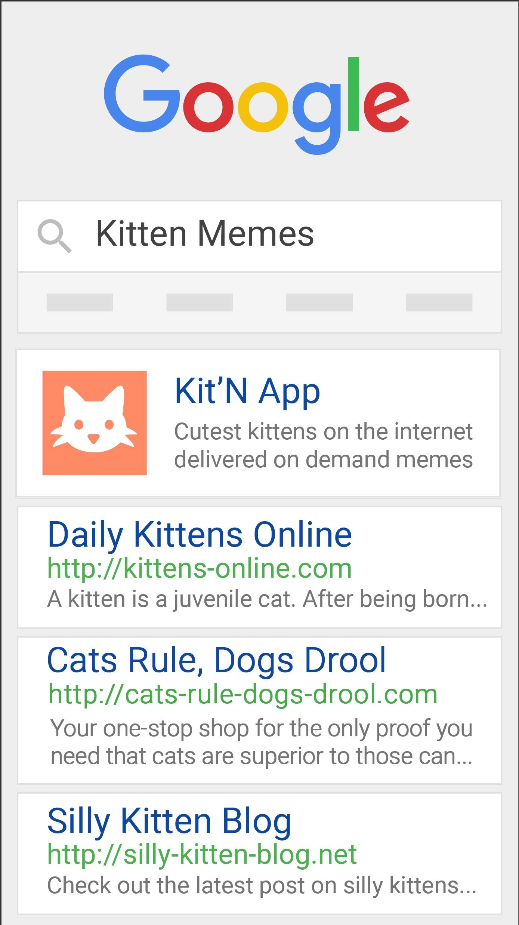
Integrate with Google Search
Index app content
Boost search ranking

Slide 26
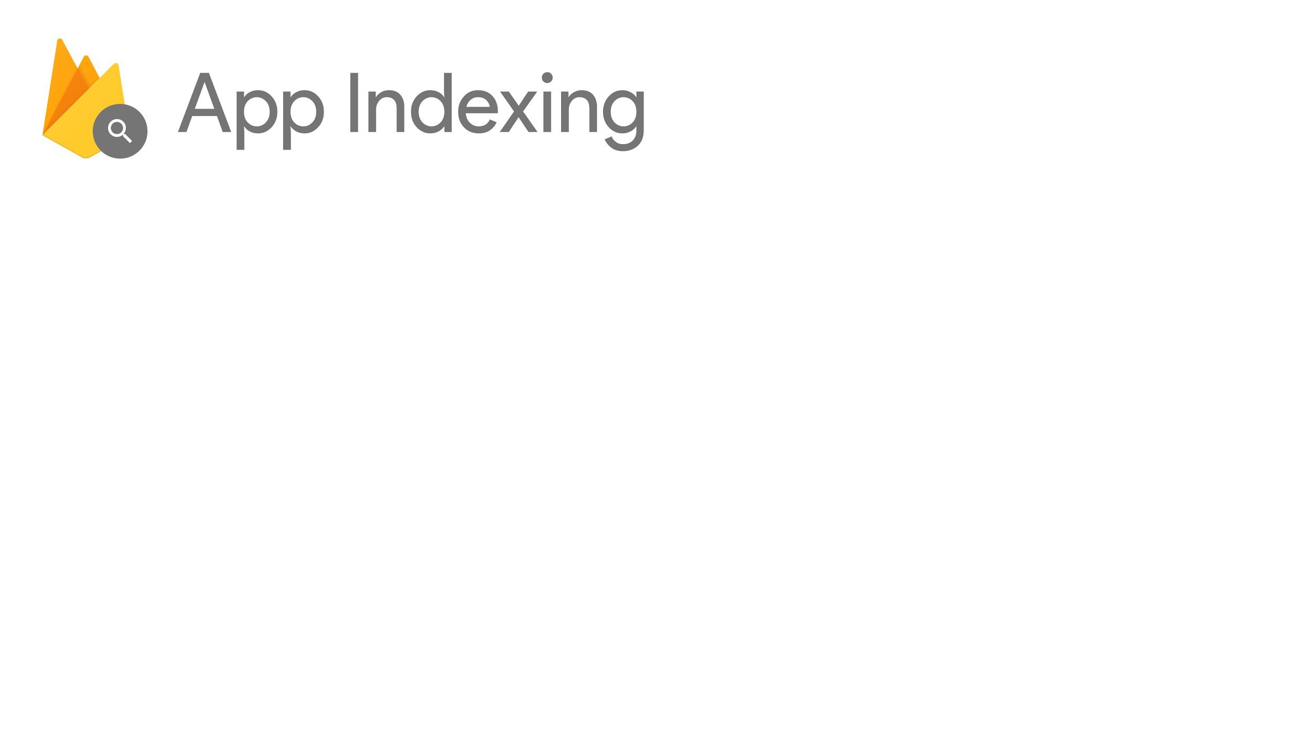


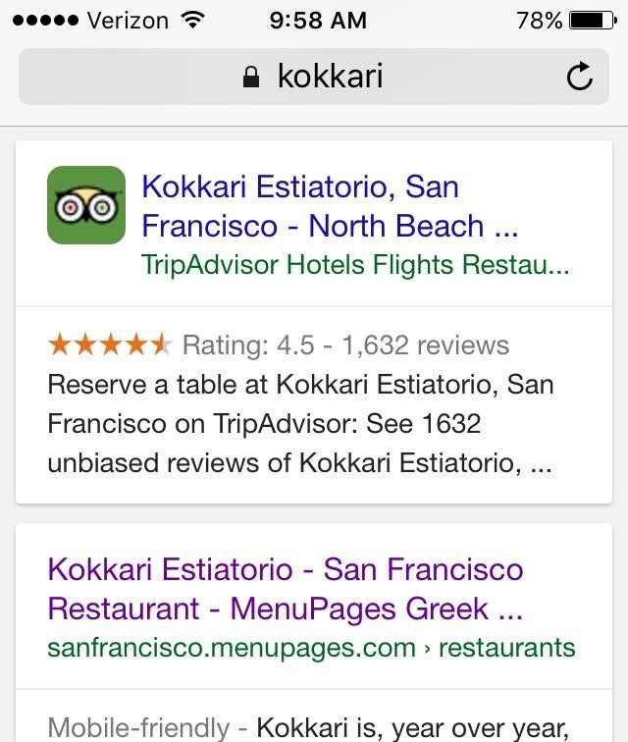
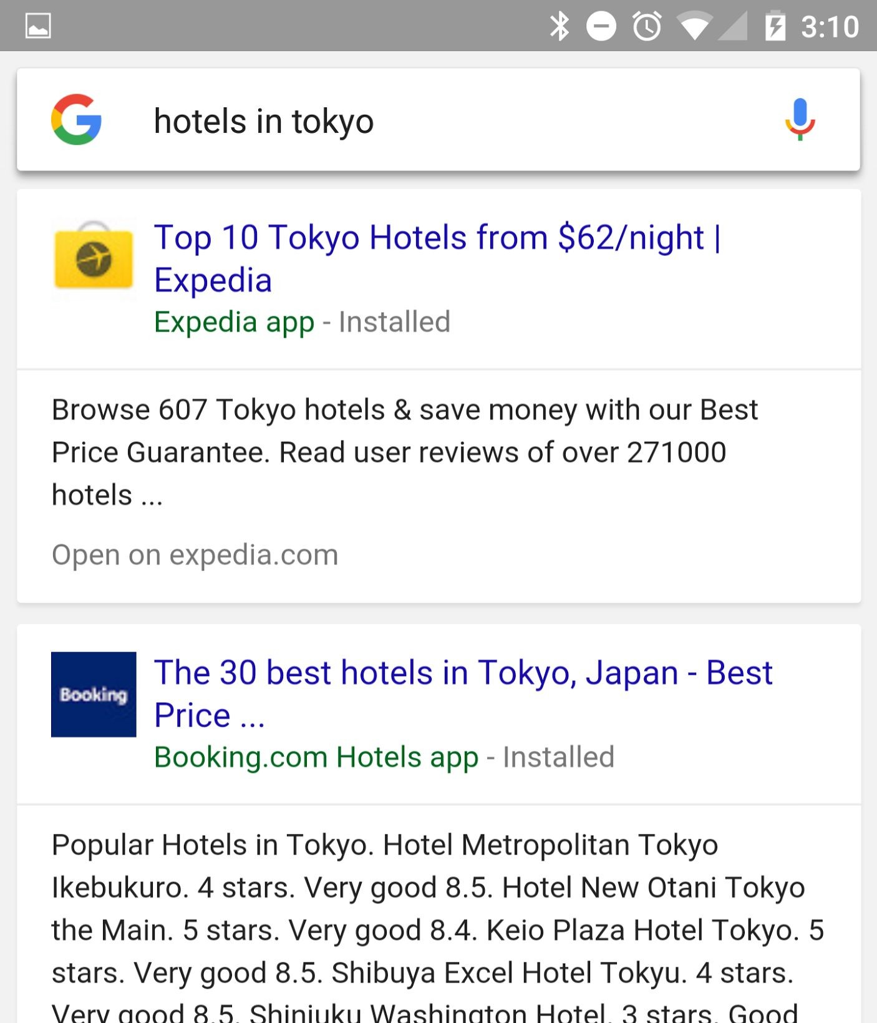

Slide 27
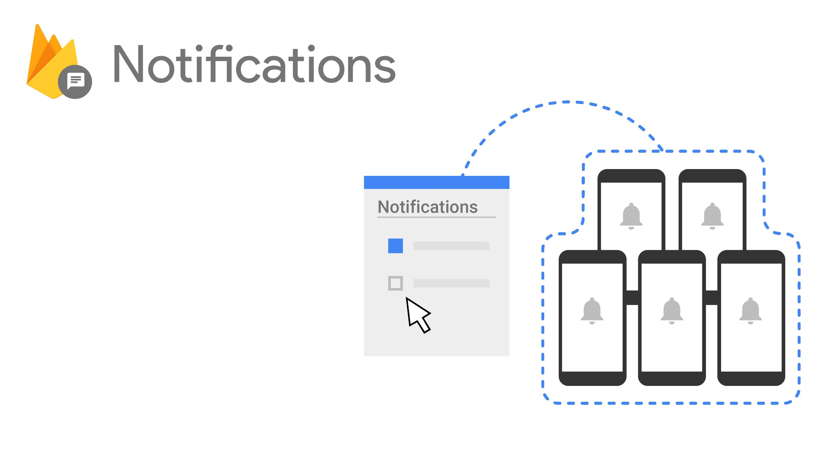

Simple UI, with no coding
Built on Cloud Messaging
Audience targeting
Conversion funnel insights

Slide 28
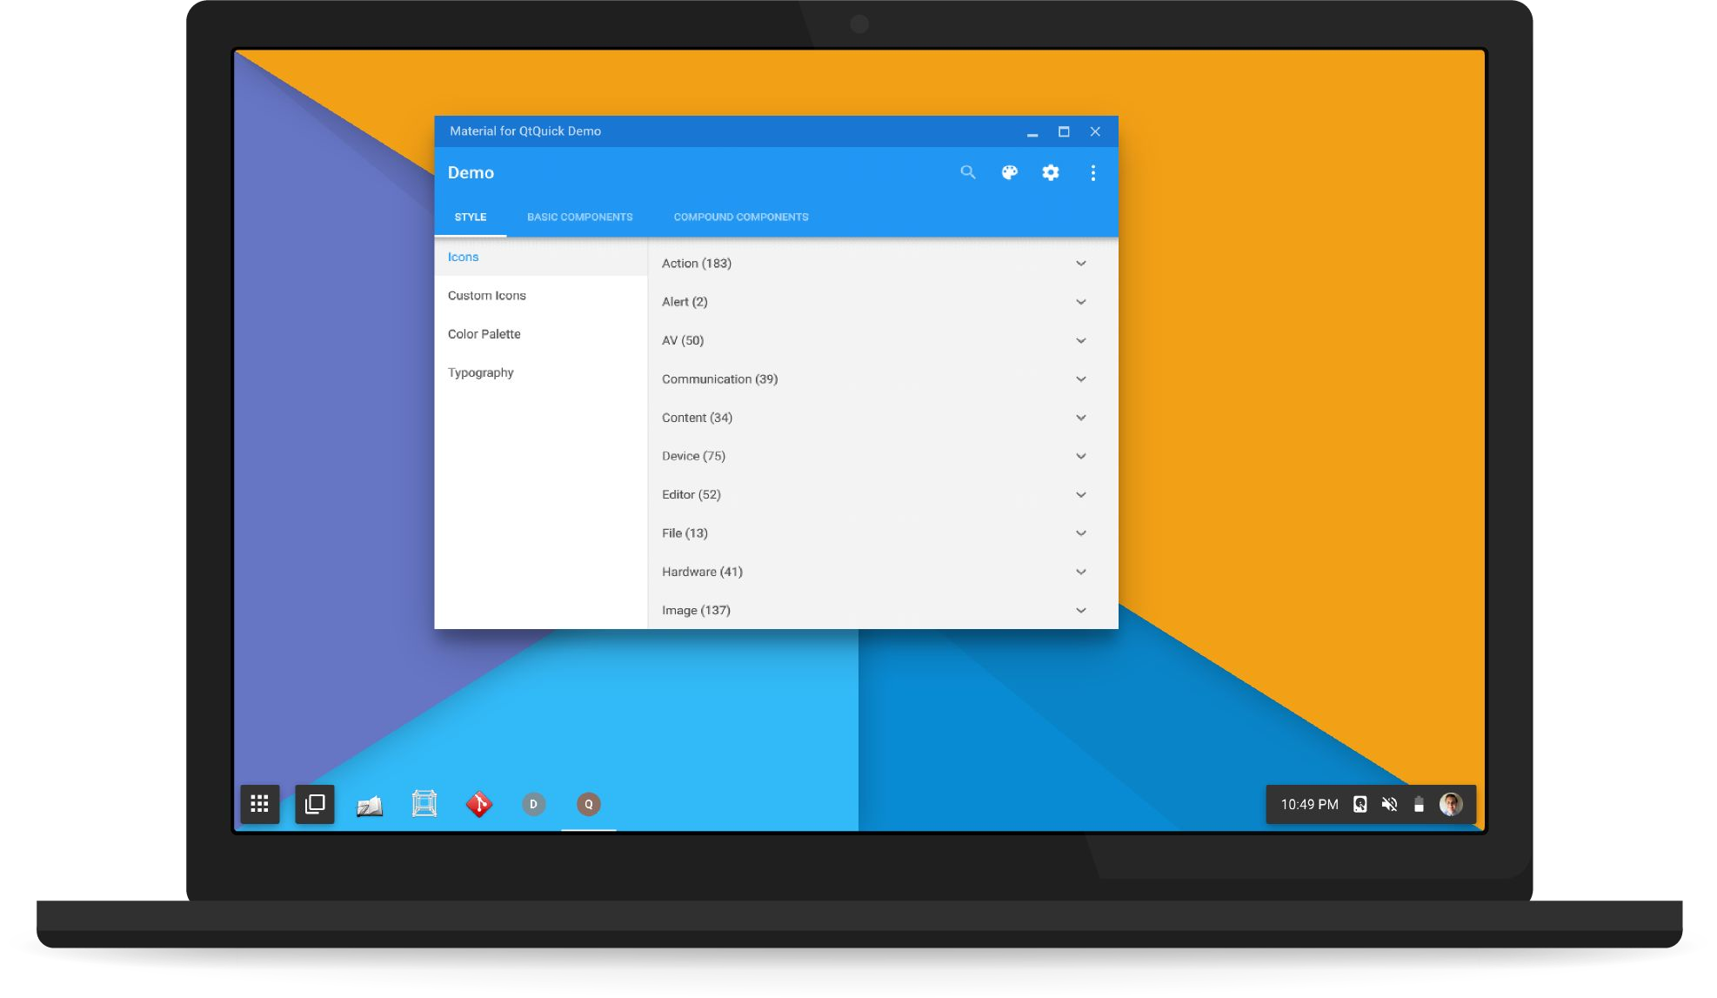
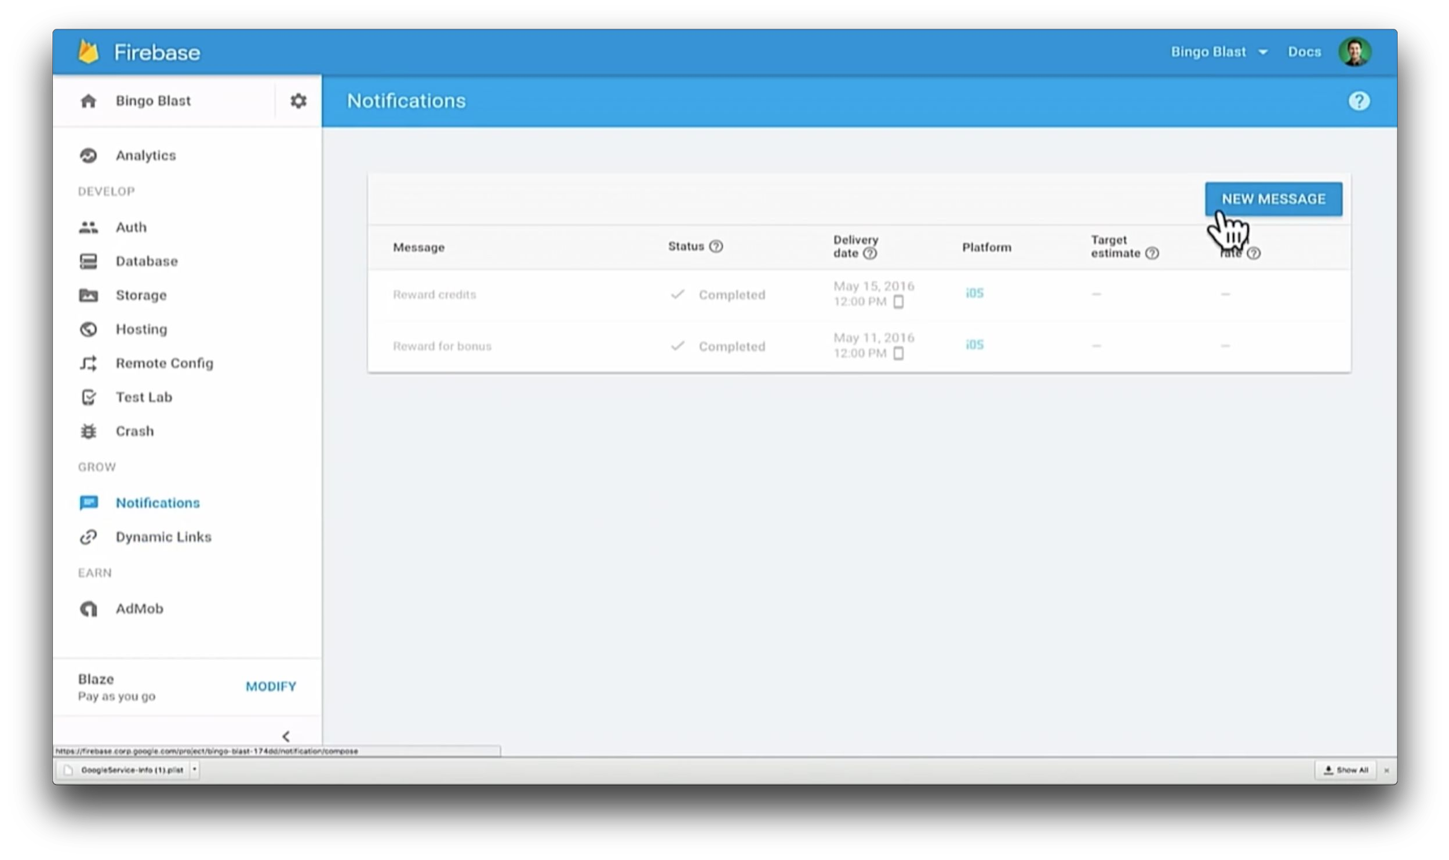

Slide 29
Earn from your app

Slide 30
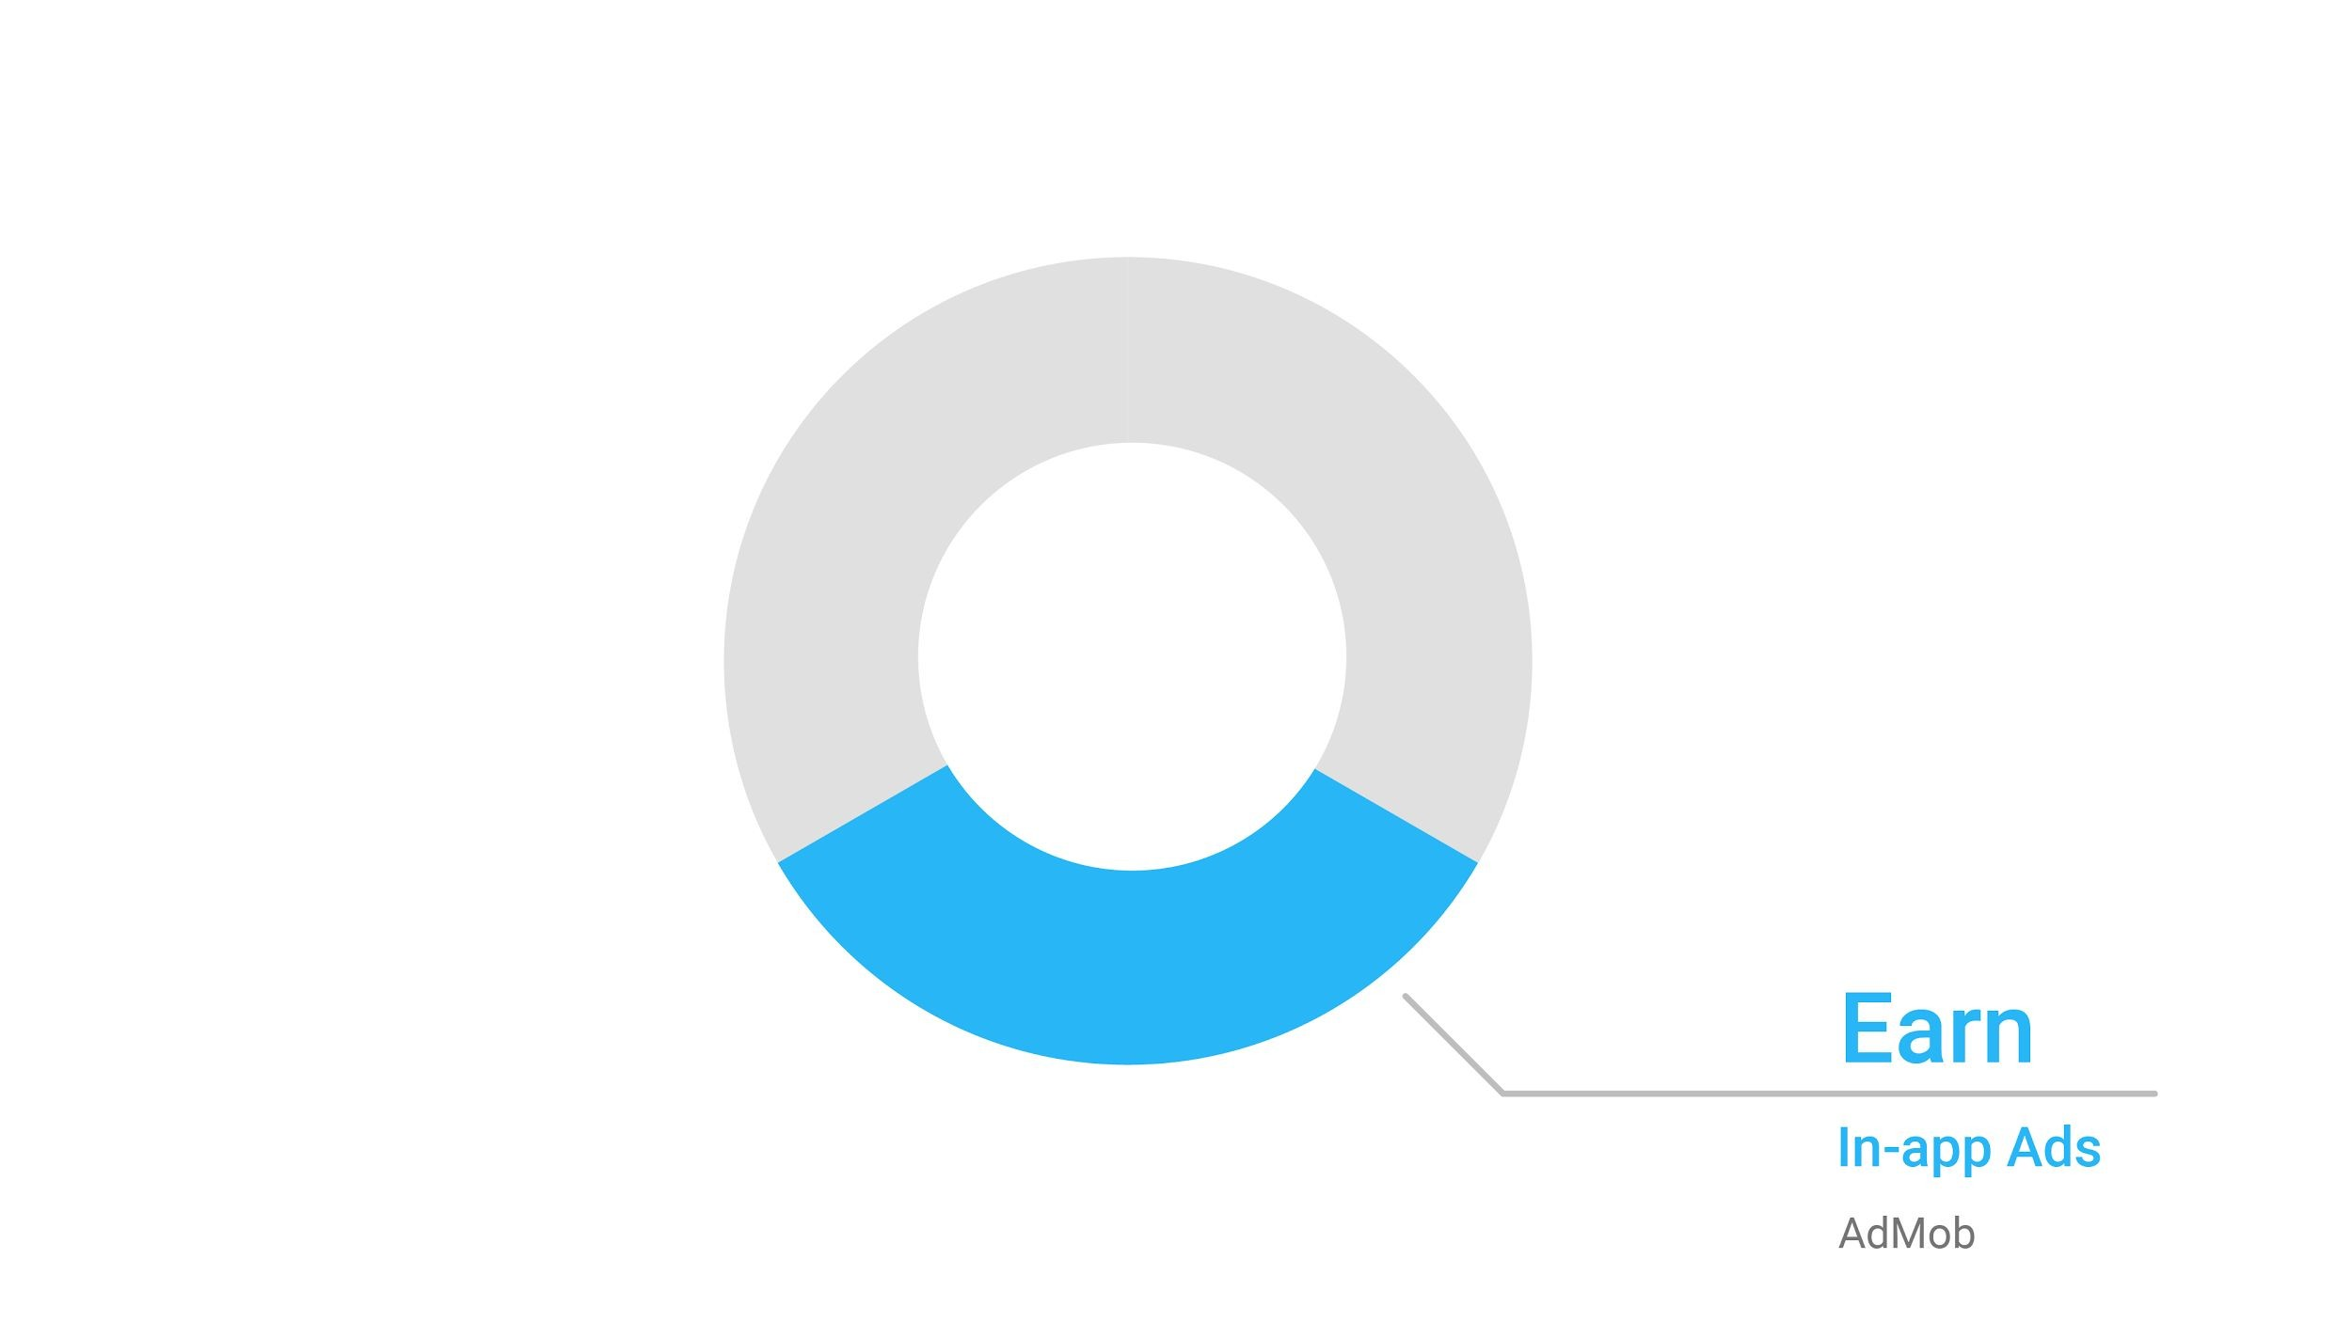

Slide 31
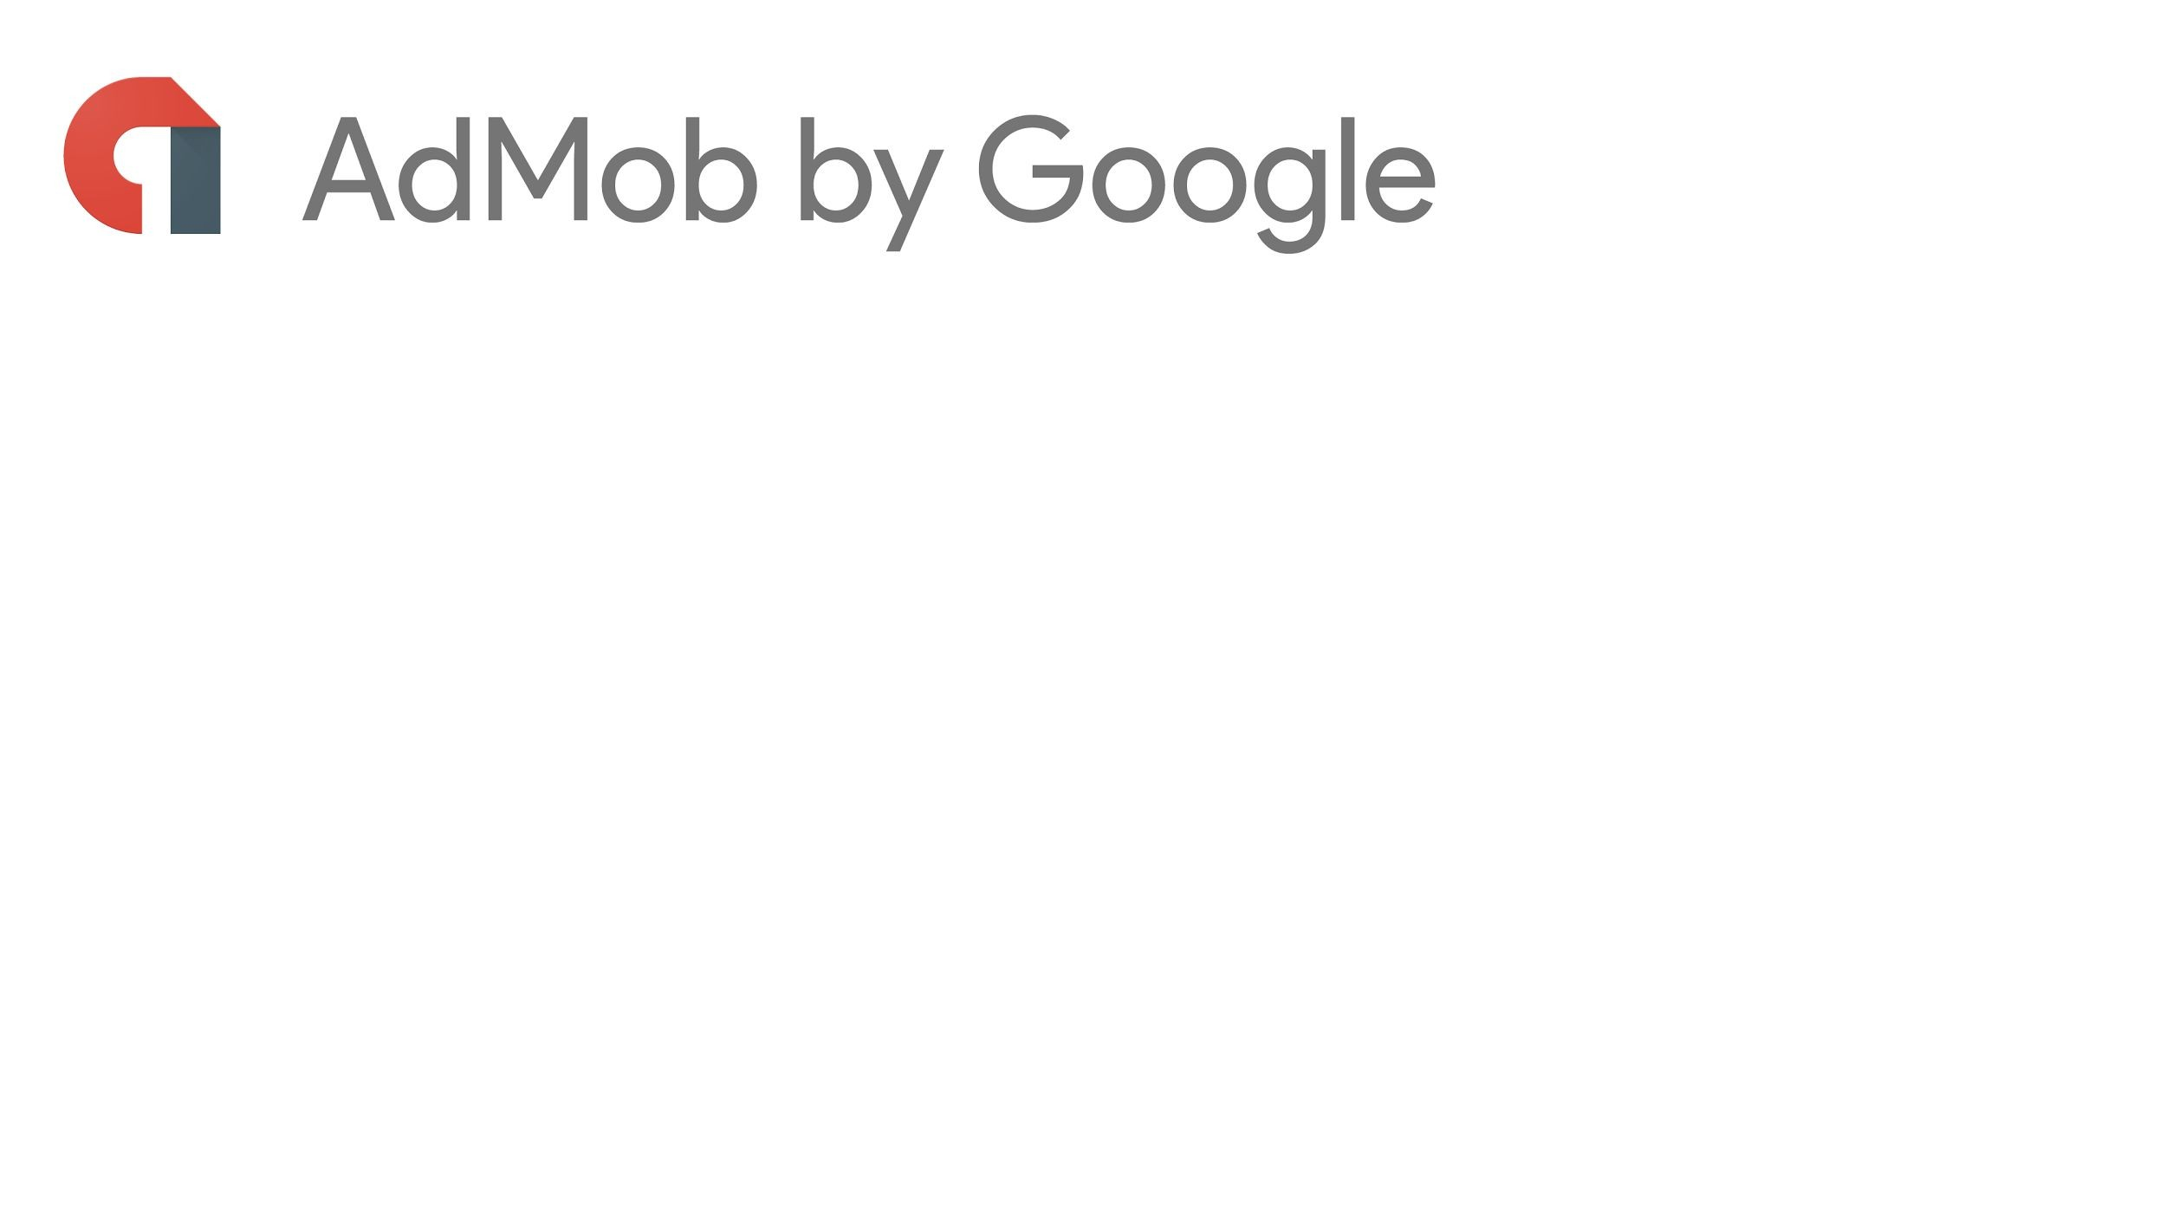


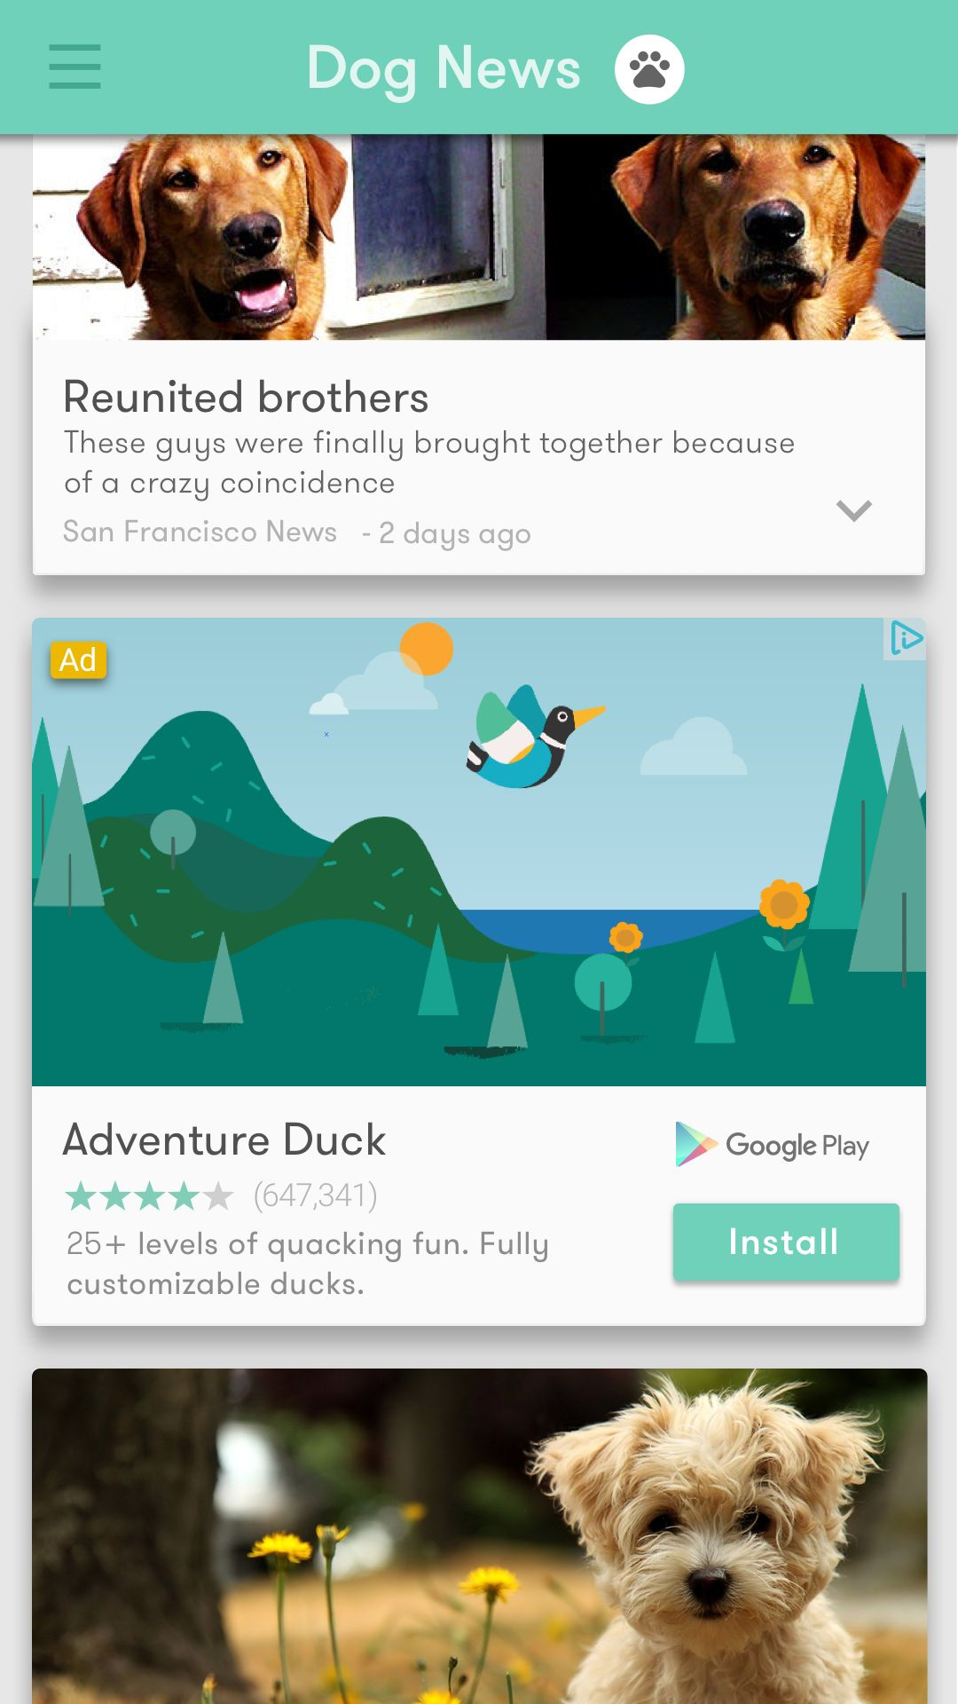


Engaging formats:
video, interstitial & native
1M+ apps using AdMob
Integrated with Firebase SDK

Slide 32
Firebase Pricing

Slide 33
